Slide 1
Computer Arabization
Marwa F. Mohamed

Slide 2
Agenda
Introduction
Course Objectives
Course Content
Course Evaluation
Projects
NLP

Slide 3
Arabization
Means the transfer of the foreign word and its meaning into Arabic according to rules and bases guaranteeing its clarity and eloquence.

Slide 4
Computer Arabization
Defined as the conversion of well-tested and well-proven computer software to enable Arabic-speaking users to utilize it effectively and efficiently.

Slide 5
Course Objectives
The course gives the students a good understanding of the Arabic language characteristics and problems with programming and different computer applications.
It gives the students the ability to think in how to localize the software to be convenient to the Arabic users.

Slide 6
Course Content
Overview of Arabic language:
Arabic Language characteristic,
Arabic language morphology
Arabic Natural Language Processing (ANLP):
Introduction to NLP
Challenges in Arabic Natural Language Processing
Machine Learning Implementations in Arabic Text Classification
Arabic Optical Character Recognition
ANLP applications ..
Arabization research activity (project discussion)

Slide 7
Course Evaluation
Code No. | Course Title | Hours |  | Marks
 |  | Lect. | Lab. | Written Exam | Oral &Lab | Test | Total
CS417 | Computer Arabization | 2 | 2 | 70 | 15 | 15 | 100

Slide 8
Projects

Slide 9
Project
OCR Application
Speech recognition Application
Arabic language Education Application
Augmented reality Application
Plagiarism Application
Sentiment Analysis Applications
Spell checking Application
Web Clustering Application

Slide 10
Project Evaluation
Documentation | Definition | 2
 | Challenges of Arabic with this APP | 3
 | Related work (at least 3) | 3
 | future work | 2
Implementation |  | 5

Slide 11
NLP

Slide 12
Natural language processing (NLP)
NLP’s general task is to make a computer understand written language in the form of words, sentences, or paragraphs.
NLP is for machines and computers to be able to successfully accomplish tasks concerning natural language.
Natural language refers to any human language that was developed through natural circumstances and follows a specific syntactic and semantic system.

Slide 13
Hapke et al. (2019) defines NLP as:
an area of research in computer science and artificial intelligence (AI) concerned with processing natural languages such as English or Mandarin.
This processing generally involves translating natural language into data (numbers) that a computer can use to learn about the world.
And this understanding of the world is sometimes used to generate natural language text that reflects that understanding.

Slide 14
Natural Language Generation (NLG)
Natural Language Generation (NLG), a subcategory of Natural Language Processing (NLP), is a software process that automatically transforms structured data into human-readable text.
Using NLG, businesses can generate thousands of pages of data-driven narratives in minutes using the right data in the right format.
NLG is a subcategory of content automation focused on text automation.

Slide 15
Natural Language Understanding (NLU)
Natural language understanding (NLU) is a subfield of natural language processing (NLP), which involves transforming human language into a machine-readable format.
NLP covers all areas of communication between humans and computers, from input to processing to response.

Slide 16
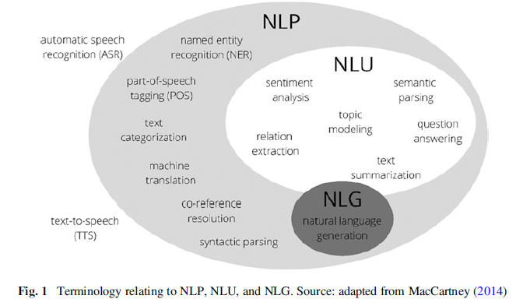
NLP and Natural Language Understanding (NLU)

Slide 17
NLP Applications
Machine Translation
Speech Recognition
Sentiment Analysis
Question Answering
Text Classification
Character Recognition
Spell Checking
Automatic Summarization

Slide 18
Machine Translation
Everyone knows what is a manual translation — we translate information from one language into another.
When the same thing is done by a machine, we deal with “Machine” Translation.
The idea behind MT is simple — to develop computer algorithms to allow automatically translation without any human intervention.
The best-known application is probably Google Translate.

Slide 19
Speech Recognition
Is the ability of a machine or program to identify words and phrases in spoken language and convert them to a machine-readable format.
Applications
virtual assistance
video games

Slide 20
Sentiment Analysis
Also known as opinion mining.
Is an interesting type of data mining that measures the inclination of people’s opinions.
The task of this analysis is to identify subjective information in the text.

Slide 21
Sentiment Analysis
For example:
this can be a movie review, or an emotional state caused by this movie.
Why do we need this? Companies use sentiment analysis to keep abreast of their reputation.
Sentiment analysis helps to check whether customers are satisfied with goods or services.

Slide 22
Question Answering
is concerned with building systems that automatically answer questions posed by humans in a natural language.
Examples of Question-Answering applications:
Siri,
OK Google,
chat boxes
virtual assistants.
Notes:
All of them have a few NLP-applications or functions — to understand speech is only half of the path and another one naturally is to give a response.

Slide 23
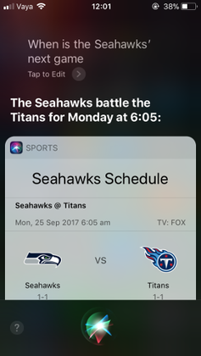
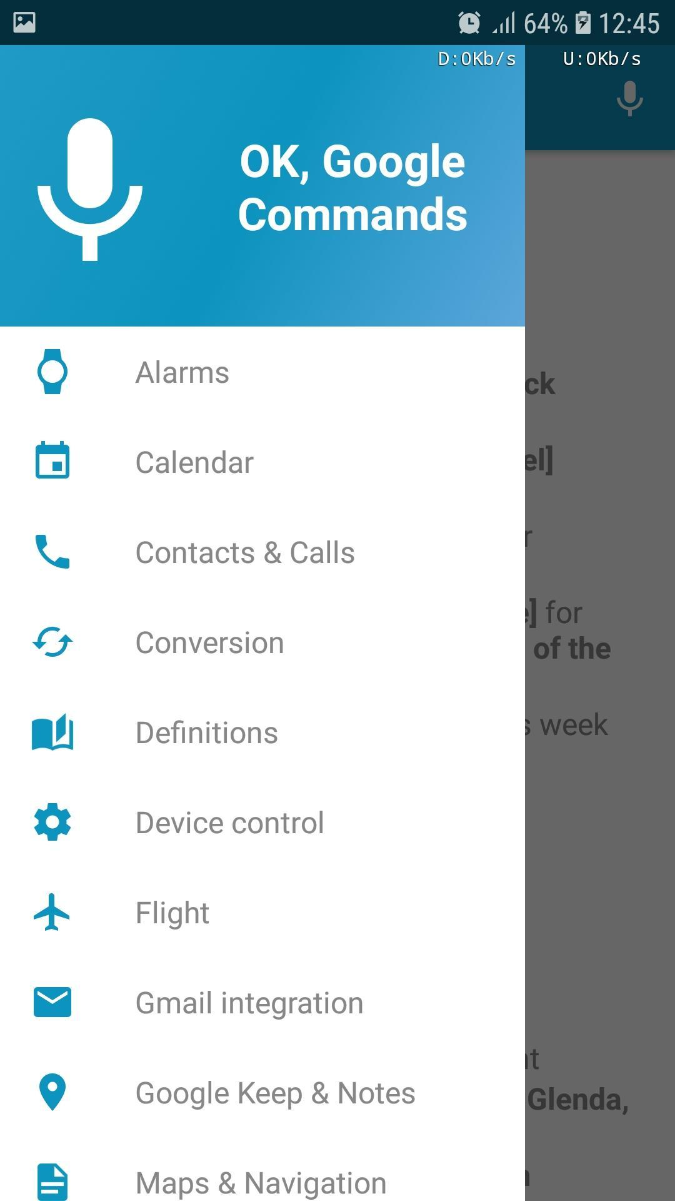

Slide 24
Text Classification
Is the task of automatic sorting of a set of documents or text scripts into categories from a predefined set.
Examples
A spam filter, has emails as its input and classifies them into one of two categories {spam, non-spam}.
News stories are typically organized by topics such as politics, sports, and economy.

Slide 25
Optical character recognition
Is the process of analyzing and identifying texts in scanned images or documents.
Examples :
invoice character recognition
check character recognition

Slide 26
Spell Checking
Is a software tool that identifies and corrects any spelling mistakes in a text.
Most text editors let users check if their text contains spelling mistakes.
Examples :
Grammarly app.

Slide 27
Automatic Summarization
Automatic summarization is the process by a which computer program creates a shortened version of text.
The product of the process contains the most important points from the original text.
Search engines such as Google use automatic summarization to produce key phrase extractions in search results.

Slide 28
Match the following technologies with their applications.
Machine Translation | video games
Spell Checking | Siri
Text Classification | C. Google Translate
Question Answering | D. Grammarly App
Speech Recognition | E. Spam Filter

Slide 29
NLP Techniques
Text Preparation and Pre-processing
Language Detection
Tokenisation
Lowercasing and Removal of Punctuation
Expand Contractions
Removal of Stop Words
Removal of URLs, HTML Tags, and Emotions/Emojis
Correction of Spelling
Part of Speech Tagging (POS)

Slide 30
Text Preparation and Pre-processing
Uncleaned data can contain many potential issues, such as misspelled words, incorrect punctuation, improper spacing, etc.,
using uncleaned data can even distort the document’s linguistics and inhibit information extraction processes.
In NLP methods, each word is viewed as a variable (dimension).
Aim is trying to keep the vocabulary and, thus, the dimensions as small as possible.
Removing noise from the document can reduce computational costs and increase NLP models’ performance

Slide 31
Language Detection
Language detection algorithms like spacy-langdetect allow the language of documents to be identified.
It makes sense to perform the language detection at the beginning of the text wrangling process in order to filter just those documents from the entire corpus that correspond to the target language and need to be processed further.

Slide 32
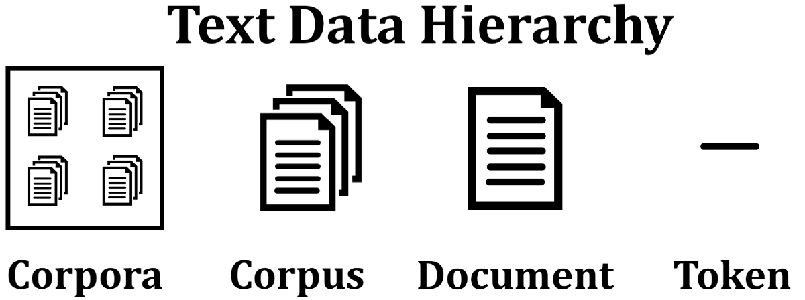

Slide 33
Corpus
A Corpus is defined as a collection of text documents for example a data set containing tweets containing Twitter data is a corpus.
So corpus consists of documents, documents consist of paragraphs, paragraphs consist of sentences.
Sentences consist of further smaller units which are called Tokens.

Slide 34
Tokenization
Languages such as English, German, Arabic, or French are space-delimited, meaning that most terms are separated by white spaces.
For languages like Thai or Chinese, however, this is not the case; as these languages do not provide clear boundaries between words, tokenization becomes a challenging task.

Slide 35
Tokenization
Tokenization is a process of splitting a text object into smaller units which are also called tokens.
The most commonly used tokenization process is White-space Tokenization :
complete text is split into words by splitting them from white spaces.

Slide 36
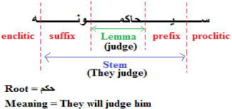
Stemming
Stemming is a rule-based process for removing the end or the beginning of words with the intention of removing affixes. and the outputs will be the stem of the world.

Slide 37
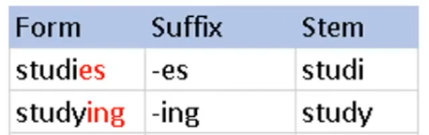
Stemming

Slide 38
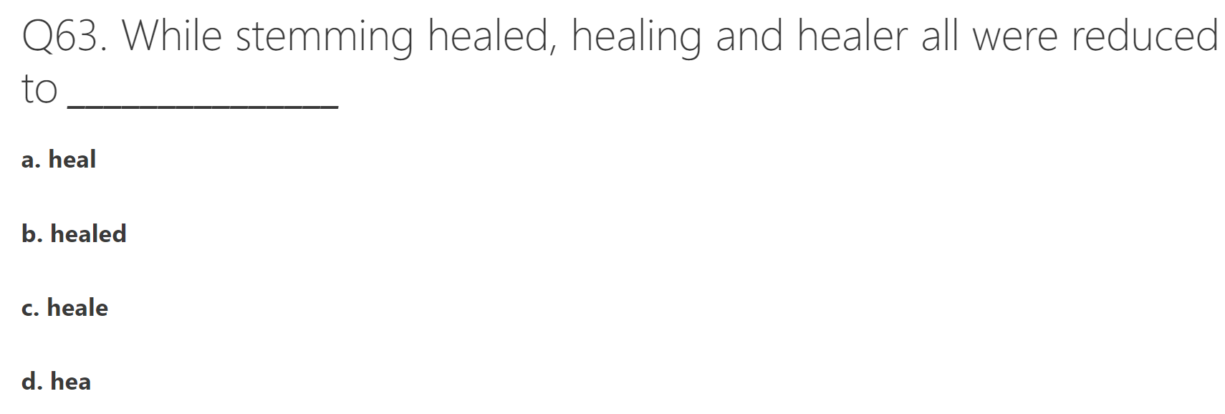
Notes:
heal

Slide 39
Lemmatization
lemmatization returns an actual word of the language, It makes use of vocabulary, word structure, part of speech tags, and grammar relations.
It is used where it is necessary to get valid words The output of lemmatization is the root word called a lemma.
For example, the words “running”, “runs” and “ran” are all forms of the word “run”, so “run” is the lemma of all the words.

Slide 40
Lowercasing and Removal of Punctuation
Usually, the transformation of text into lowercase letters and the removal of punctuation are considered the first pre-processing steps.
Lowercase text data is particularly relevant so as to avoid word redundancy.
For example, when counting words, the terms “Tourism” and “tourism” would be counted as two separate words, leading to an undesired increase in the dimensions of the data.

Slide 41
Lowercasing and Removal of Punctuation
Punctuation marks create noise in the data and do not add value to the analysis, explaining why they should be removed.
However, in certain situations, it makes sense to analyze individual sentences; in such cases, the corpus should be separated into individual sentences before punctuation marks are removed.

Slide 42
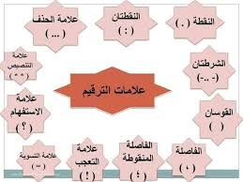

Slide 43
Expand Contractions
A contraction is “a shortening of a word, syllable, or word group by omission of a sound or letter”.
For instance, a contraction like “we’ll” is split into two words, “we” and “will”.

Slide 44
Removal of Stop Words
Stop words are common words in English such as “a, in, the, can, may”, and so on.
These words are not useful in NLP analyses because they can be part of any sentence;
In other words, stop words are not considered keywords in text mining methods.
Furthermore, they increase vocabulary and hardly provide useful information.

Slide 45
Removal of Stop Words
There are numerous Python packages that can be used to load stop words, with each package varying in size.
For example, the NLTK (Natural Language Toolkit) package stores a list of stop words for 16 different languages, with 127 stop words specified for English, while the Stanford NLP package contains 257 English stop words.
In most cases, one will use standard stop words but can add individually defined stop words as well.

Slide 46
Removal of URLs, HTML Tags, and Emotions/Emojis
Regarding social media posts from Twitter, Facebook, or Instagram, URLs are often a part of documents.
However, these limit NLP algorithms from recognizing the actual meaning of a sentence.
Thus, they are merely noise within a text and should be deleted.
The same applies to HTML tags as well as emoji’s and emoticons.
Even though they convey information about feelings, we might not want to analyze them and are better off being removed from the data.

Slide 47
Correction of Spelling
Spelling errors can be seen as another example of increasing the number of features in a vocabulary due to corresponding words being counted twice.
For example, the words “tourism” and “turism” would be considered two different words.
To correct spelling errors, many different Python packages using different approaches are available, such as “pyspellchecker”, “SymSpell”, “TextBlob Spell Checker”, etc.
However, their execution time and performance differ significantly.

Slide 48
Part of Speech Tagging (POS)
With part of speech tagging, individual tokens are labeled based on their parts of speech.
This can be achieved using language models that include dictionaries of terms with all their possible parts of speech
For instance, both NLTK3 and spaCy are Python modules that enable extensive POS.

Slide 49
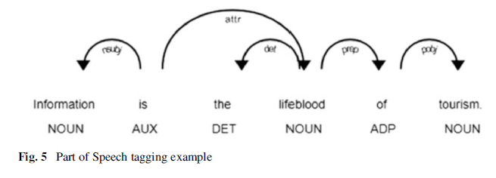
Part of Speech Tagging (POS)

Slide 50
Advantages of Natural Language Processing:
Improves human-computer interaction: NLP enables computers to understand and respond to human languages, which improves the overall user experience and makes it easier for people to interact with computers.
Automates repetitive tasks: NLP techniques can be used to automate repetitive tasks, such as text summarization, sentiment analysis, and language translation, which can save time and increase efficiency.
Enables new applications: NLP enables the development of new applications, such as virtual assistants, chatbots, and question answering systems, that can improve customer service, provide information, and more.

Slide 51
Advantages of Natural Language Processing:
Improves decision-making: NLP techniques can be used to extract insights from large amounts of unstructured data, such as social media posts and customer feedback, which can improve decision-making in various industries.
Improves accessibility: NLP can be used to make technology more accessible, such as by providing text-to-speech and speech-to-text capabilities for people with disabilities.

Slide 52
Disadvantages of Natural Language Processing:
Limited understanding of context: NLP systems have a limited understanding of context, which can lead to misinterpretations or errors in the output.
Requires large amounts of data: NLP systems require large amounts of data to train and improve their performance, which can be expensive and time-consuming to collect.

Slide 53
Disadvantages of Natural Language Processing:
Limited ability to understand idioms and sarcasm: NLP systems have a limited ability to understand idioms, sarcasm, and other forms of figurative language, which can lead to misinterpretations or errors in the output.
Limited ability to understand emotions: NLP systems have a limited ability to understand emotions and tone of voice, which can lead to misinterpretations or errors in the output.

Slide 54
Task

Slide 55
What the different between
NLP
NLU
NLG

Slide 56
Practical (using Python)
How to Detect Arabic Language ?

Slide 57
References
Al-Shbiel, A.O., 2017. Arabization and its effect on the Arabic language. Journal of Language Teaching and Research, 8(3), pp.469-475.
Al-Salman, A.S., 1996. An Arabic programming environment. ACM SIGICE Bulletin, 22(2), pp.19-25.
Shaalan, K., Siddiqui, S., Alkhatib, M. and Monem, A.A., 2018. Challenges in arabic natural language processing. Computational Linguistics, Speech And Image Processing For Arabic Language, 4, p.59.
https://morioh.com/p/d596d2d4444d
Egger, R. and Gokce, E., 2022. Natural language processing (NLP): An introduction. In Applied Data Science in Tourism (pp. 307-334). Springer, Cham.

